Slide 1


MT3D-USGS: A primer

Slide 2
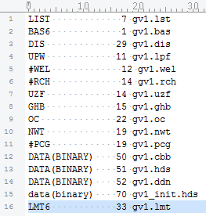

Mass Transport in 3D for Multiple Species
Many similarities with MODFLOW
Modular
Distributed-parameter
Physically-based
Finite-difference
“Piggy-backs” on MODFLOW-calculated fluxes
Solves the advection-dispersion-reaction equation for non-interacting species.

Slide 3
History
Was the launching pad for other transport codes
RT3D (Clement, 1997)
“Reactive Transport in 3-Dimensions”
SEAM3D (Waddill and Widdowson, 1998)
“Sequential Electron Acceptor Model in 3-Dimensions”
GMT3D (Guerin and Zheng, 1998)
“Geochemical Mass Transport in 3-Dimensions”
BioRedox-MT3DMS (Carey et al., 1999)
PHT3D (Prommer et al., 2003)
Integration of PHREEQC with MT3D
SEAWAT (Langevin et al., 2003)
Integration of MODFLOW with MT3DMS for density dependent flow
Some others to follow

Slide 4
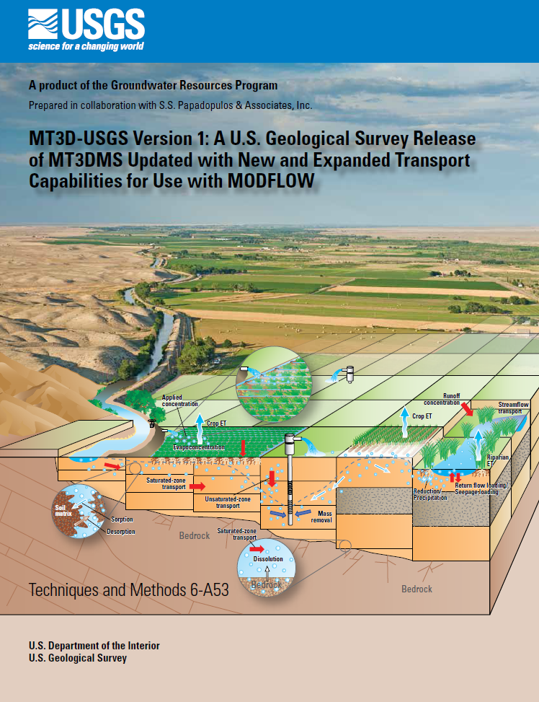
Next Generation of MT3D
“MT3D-USGS”
Emerges from MT3DMS
Source code modified to modules protocol
Effort made to maintain backward-compatibility

Slide 5
Governing Equation Solved by MT3D-USGS
Dispersion
Advection
Sources and Sinks
Reactions
Transient GW storage

Slide 6
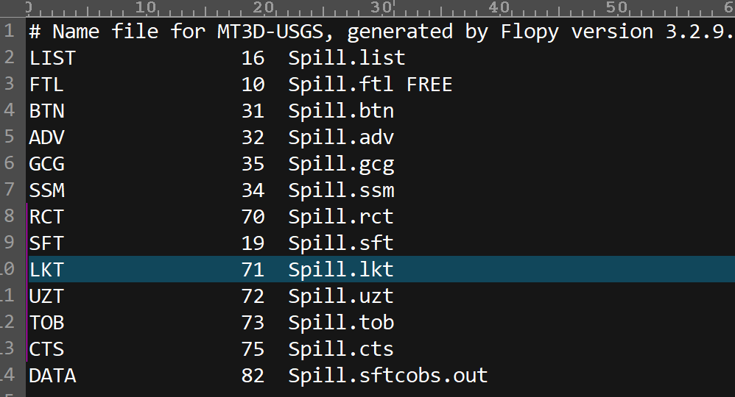
Packages

Slide 7
New functionality available with MT3D-USGS
4 new packages
Contaminant Treatment System (CTS)
Unsaturated-Zone Transport (UZT)
Streamflow Transport (SFT)
Lake Transport (LKT)

Slide 8


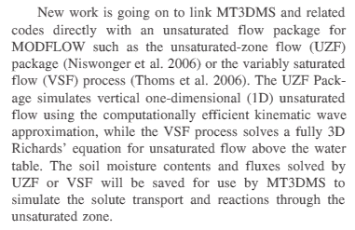
Fulfillment of Future Directions for MT3DMS
Sept/Oct 2009

Slide 9
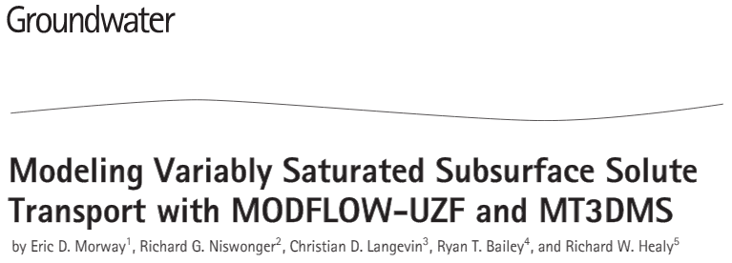

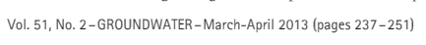
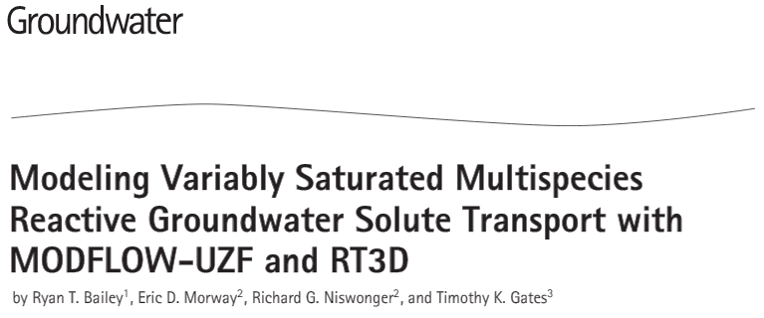
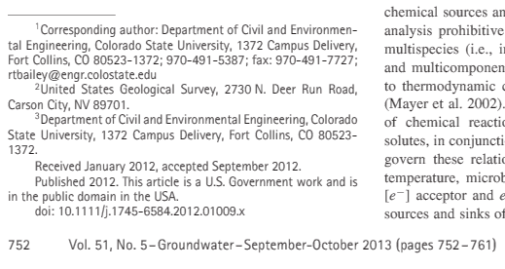
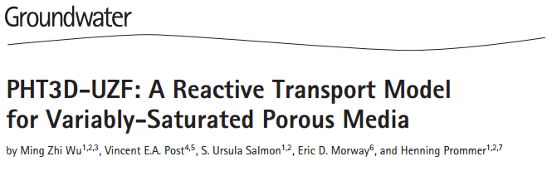
Recent History

Slide 10
Show UZF Animations
Keating with and without accounting for unsaturated zone
Comparison with VS2D for a sand and silt case

Slide 11
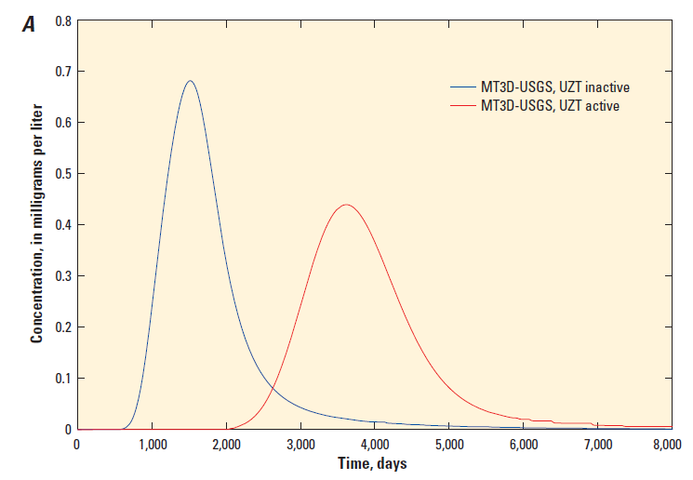
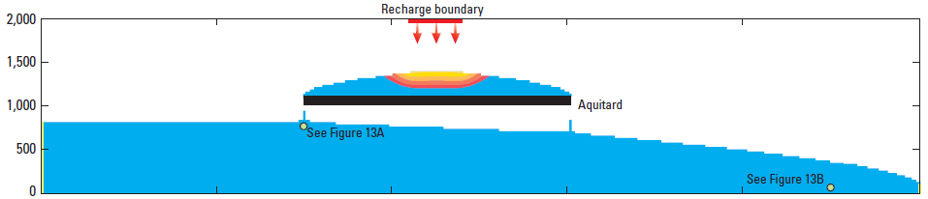
Breakthrough curves with and w/o UZT

Slide 12
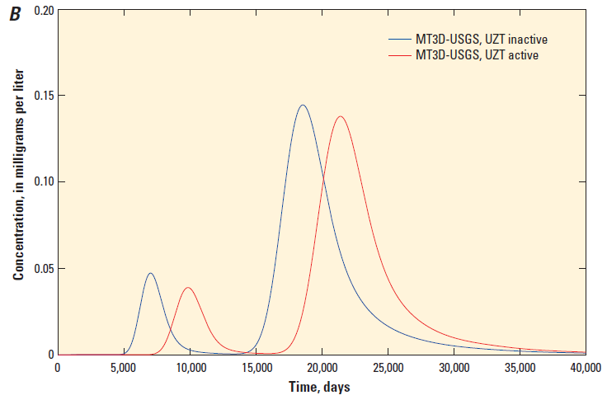
Including the UZT package

Slide 13
Demonstration of SFT
MODFLOW simulation will need to have the SFR package activated
Keep an eye on the linker file size
An additional benchmark in the MT3D-USGS documentation

Slide 14
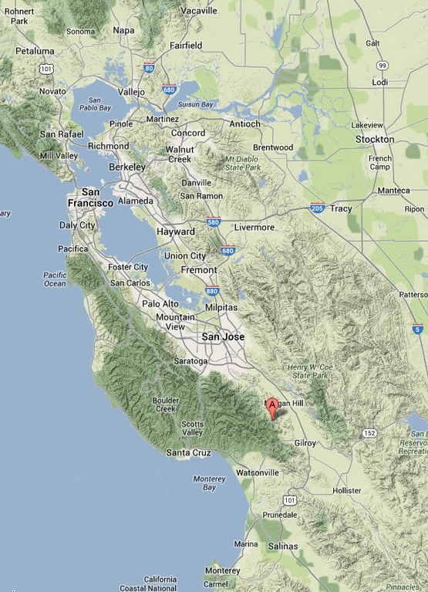

SFT Benchmark
Injection Point
38 m
105 m
0 m
N
FLOW
281 m
433 m
619 m

Slide 15
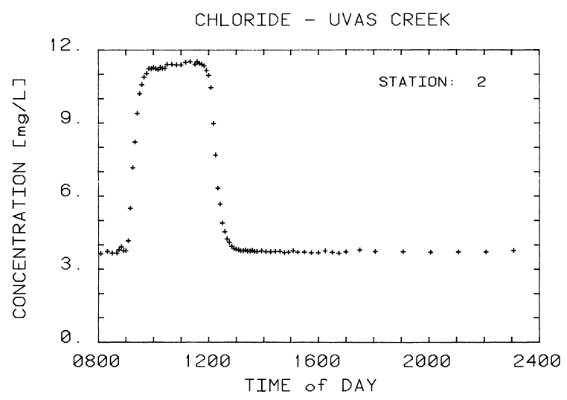
SFT Benchmark
Injection Point
38 m
105 m
0 m
N
FLOW
281 m
433 m
619 m

Slide 16
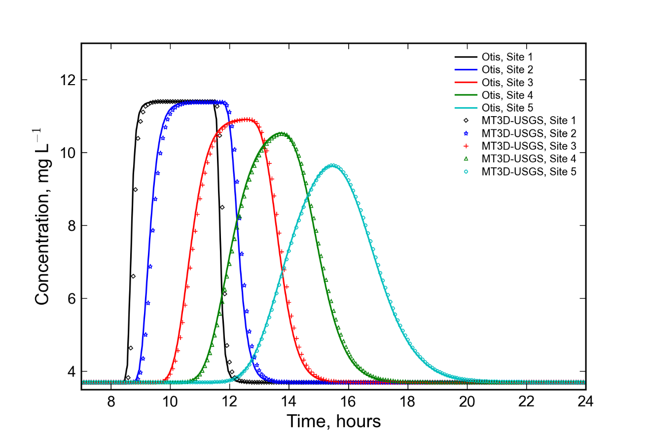
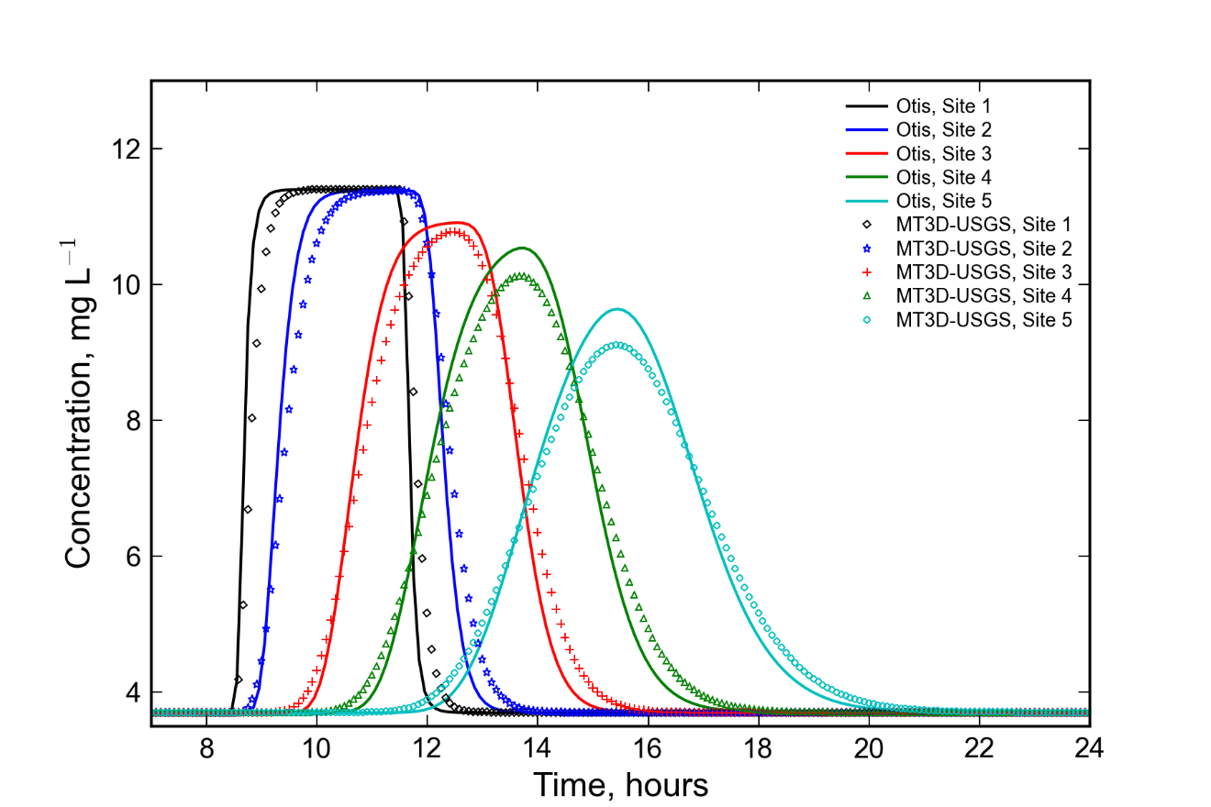
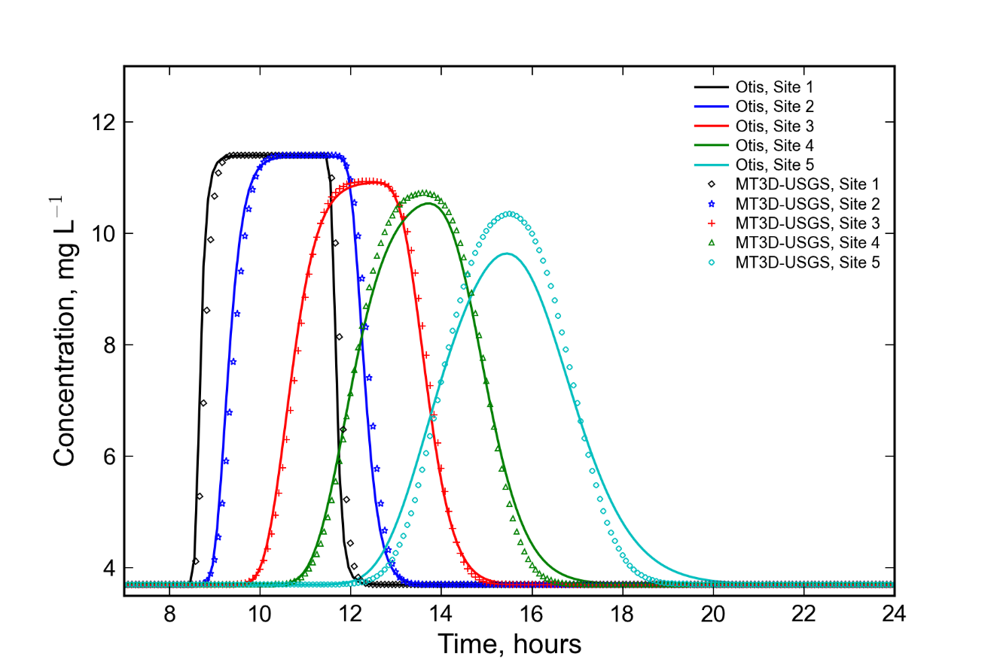
SFT Benchmarks
Fully Implicit Scheme, With Disp.
Crank-Nicolson Weighting, w/ Disp.
Fully Implicit Scheme, No Disp.

Slide 17
Thermal Transport

Slide 18
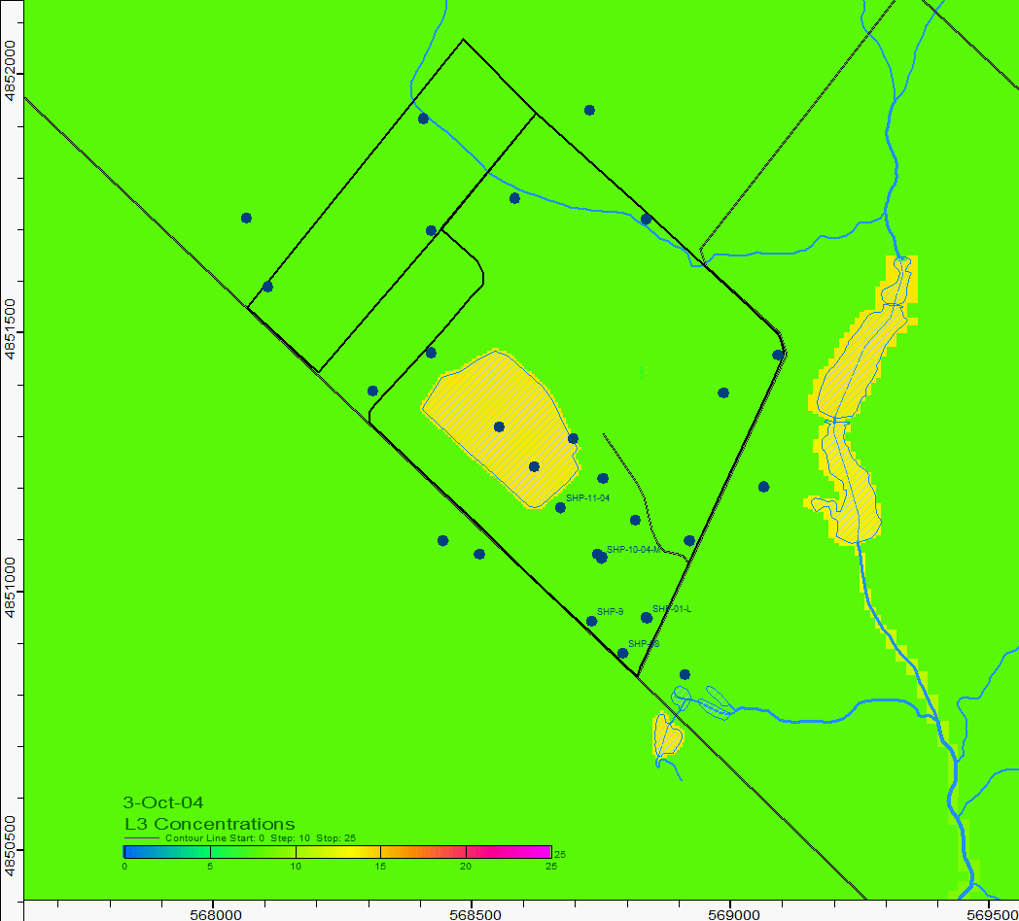
Thermal Transport from a Gravel Pit Lake
Simulated with MT3D-USGS
Animation shows simulated temperature in Layer 3.
Also shows temperature change in nearby lakes and streams
Results show pulse of high and low temperature water moving southeast from the pond.

Slide 19
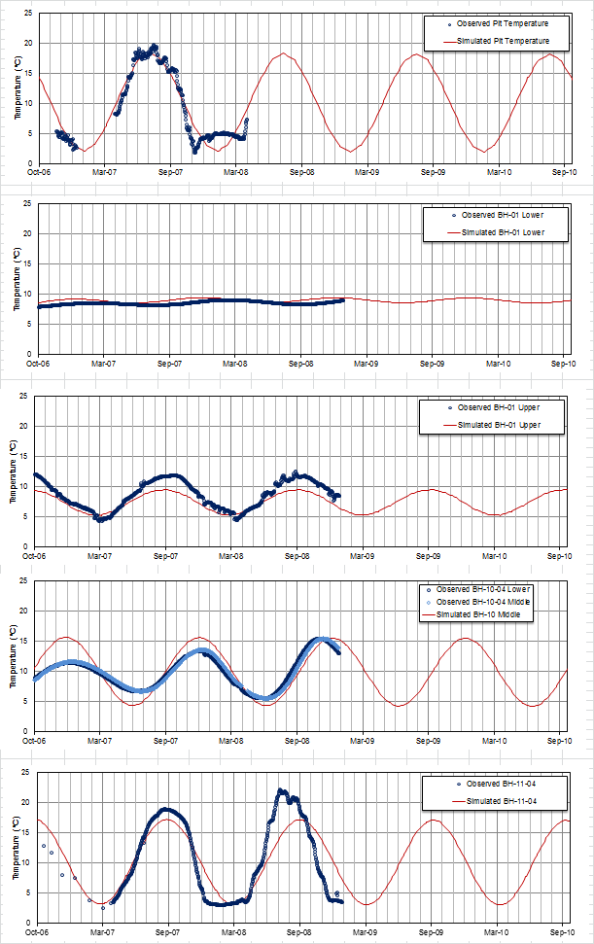

Slide 20
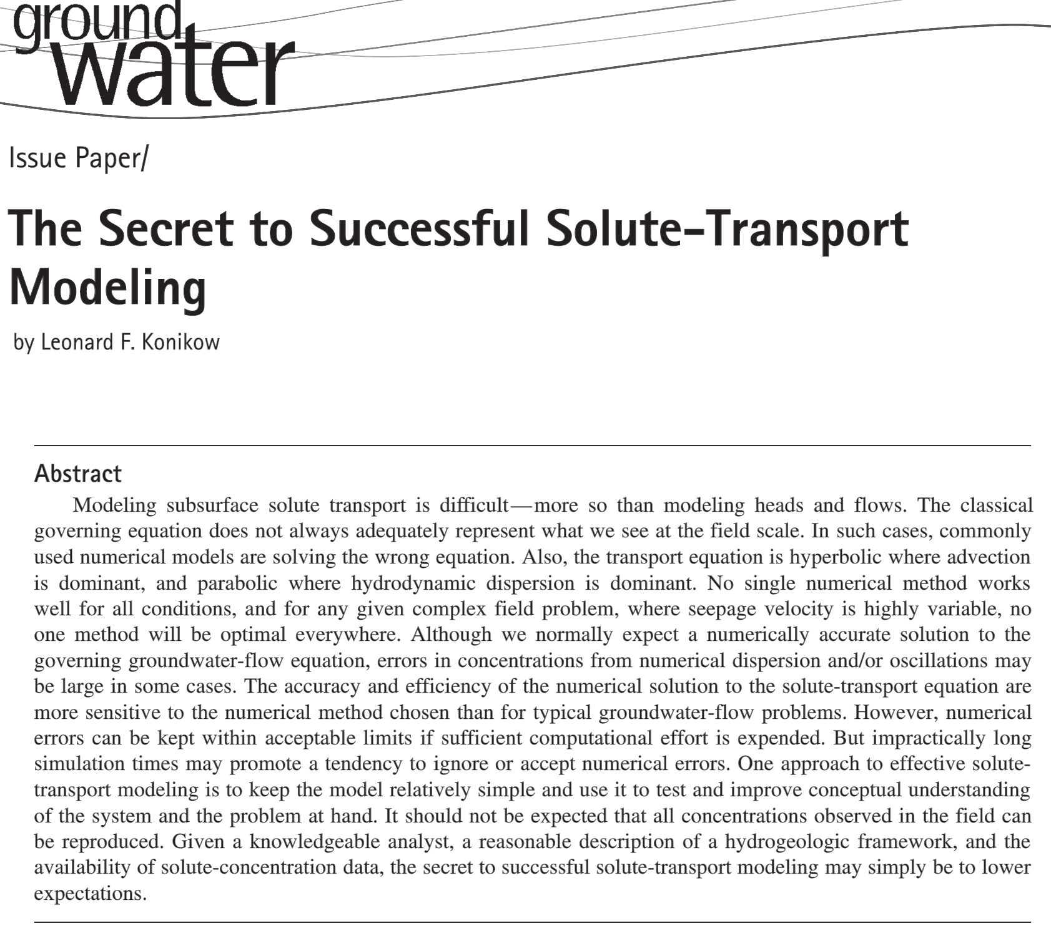
Applying MT3DMS
Notes:
Proper allocation of groundwater flow and transport can indeed lead to an improved understanding of a problem involving transport. Remember, when we engage in modeling, it is not the model itself that is our goal. Rather, the principle goal is to increase our understanding of a system and the processes in play, and it is the models that help us toward this end.

